Slide 1
ITS 4.1 Student System Improvements
Presenter: Linda Putu

Slide 2
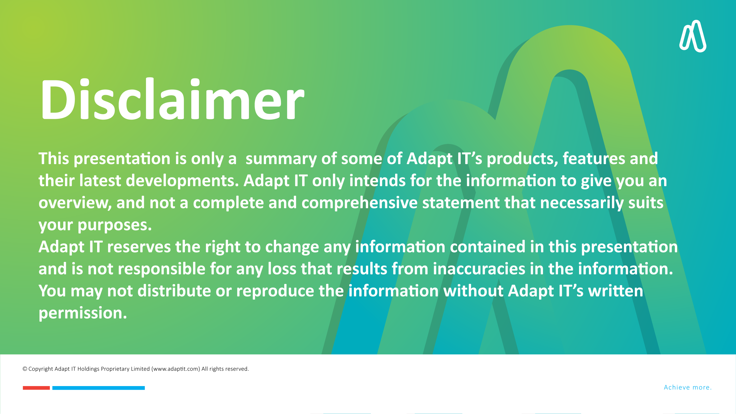

DISCLAIMER
This presentation is only a summary of some of Adapt IT’s products, features and their latest developments. Adapt IT only intends for the information to give you an overview, and not a complete and comprehensive statement that necessarily suits your purposes.
Adapt IT reserves the right to change any information contained in this presentation and is not responsible for any loss that results from inaccuracies in the information. You may not distribute or reproduce the information without Adapt IT’s written permission.

Slide 3

HEPSA
Mandatory Documents
Registration Quotas
Graduation Improvements
Ad hoc groups
LMS API
Residence
  - Query Assets
  - Bulk Admission
Security on iEnabler
Roadmap
Table of contents

Slide 4

Student Team
Team Values Define Culture
Unwavering Support Fuelling Growth
Fostering an Uplifting Culture

Slide 5
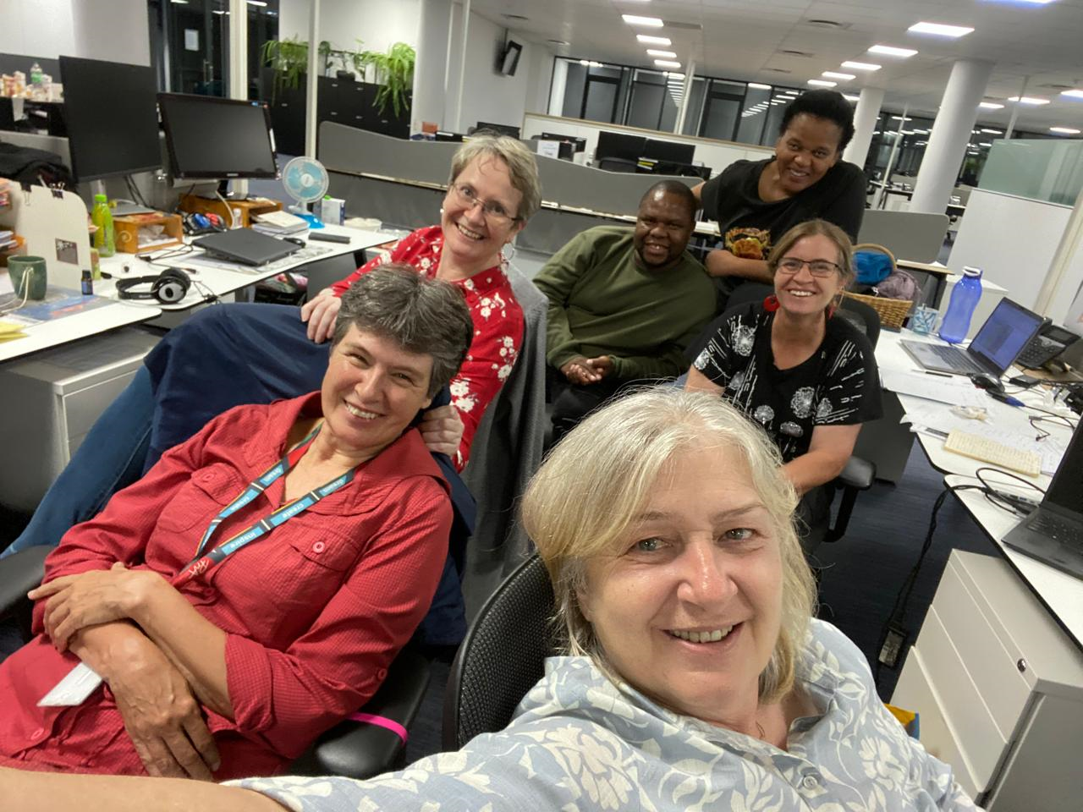
Dedication in Action: Matric Results Upload Team at 3:23 AM

Slide 6
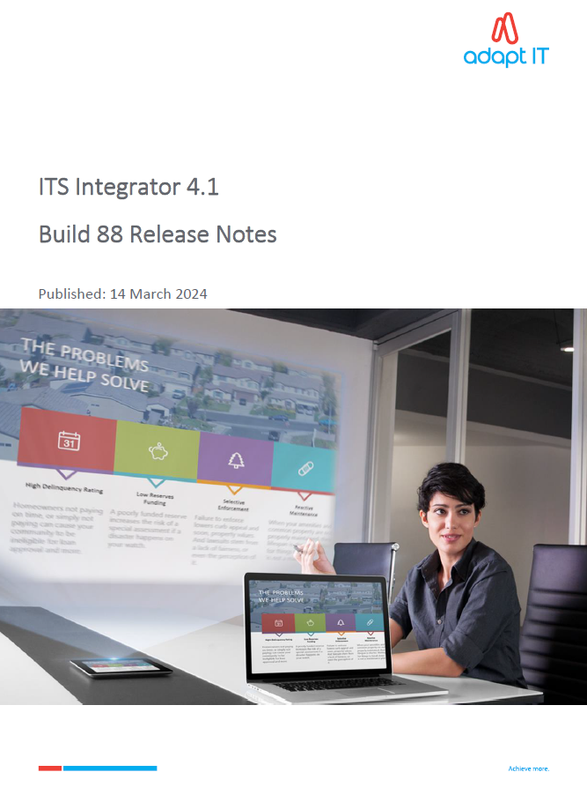
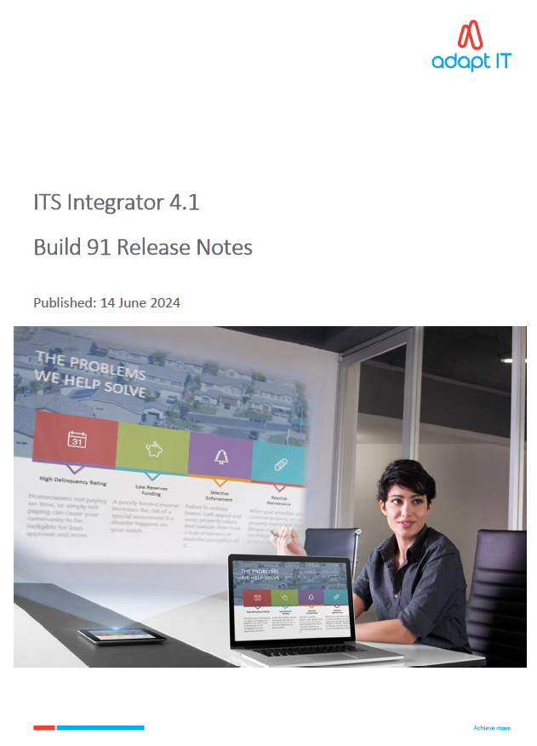
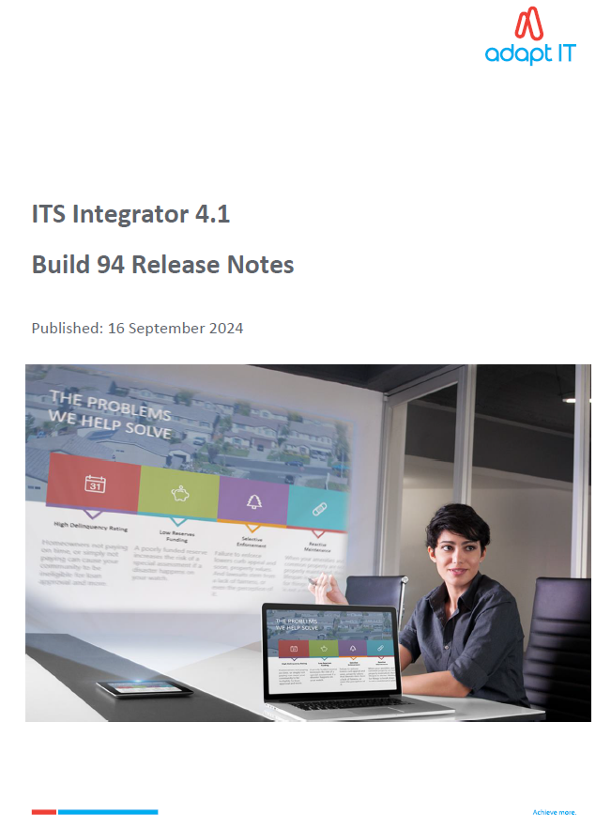
Builds and Release notes

Slide 7
HEPSA

Slide 8
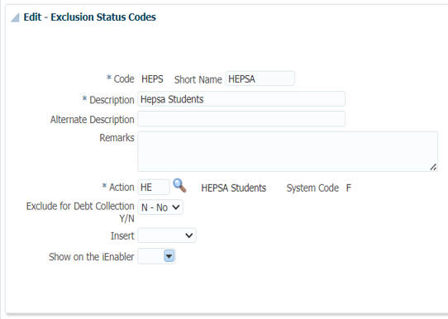
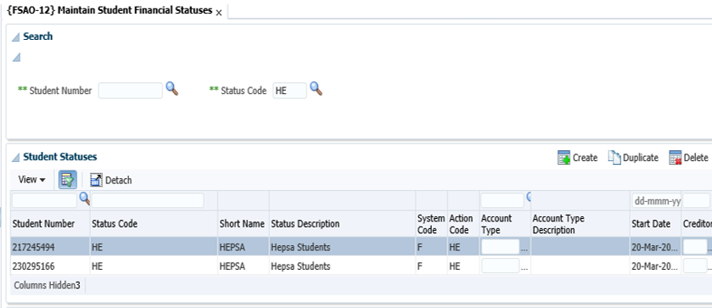
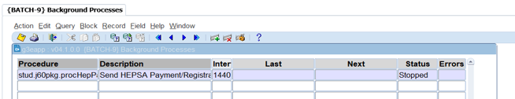
HEPSA

Slide 9
Mandatory Documents

Slide 10
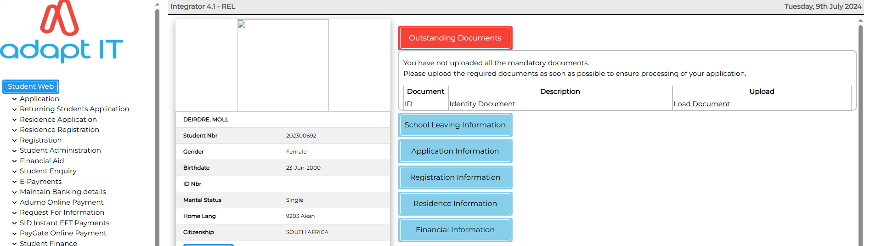
Dashboard on Mandatory Documents

Slide 11
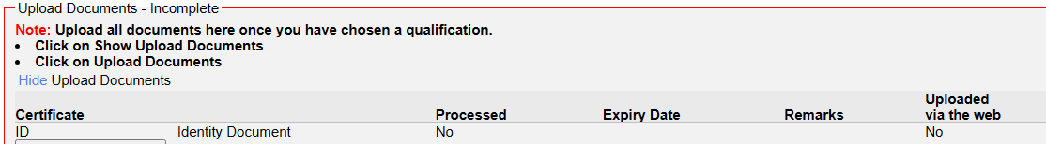
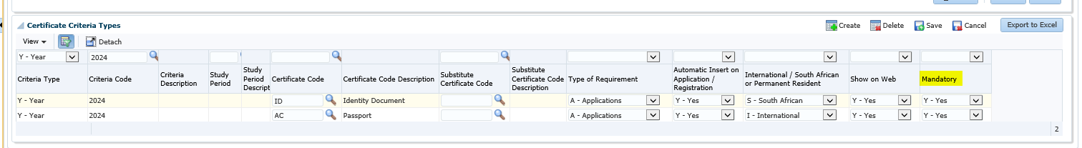
Mandatory Documents

Slide 12
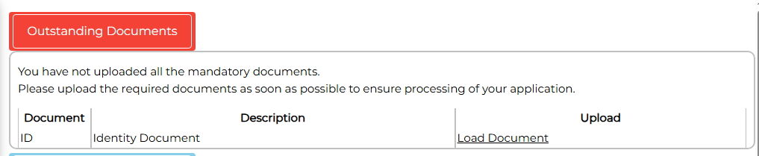
Dashboard Link

Slide 13
Registration Quotas

Slide 14
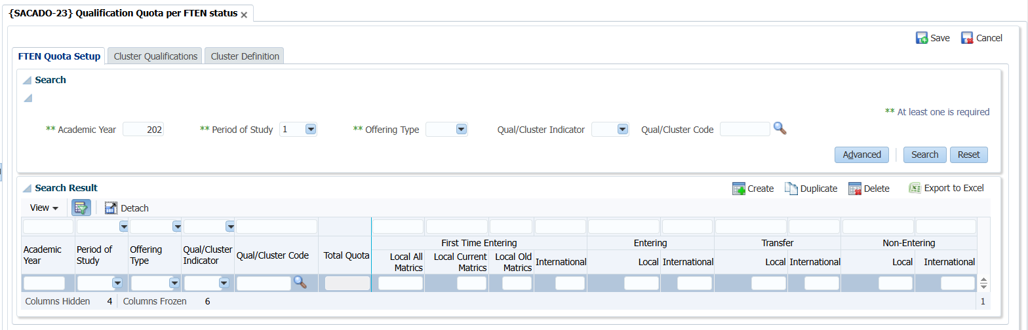
{SACADO-23} Qualification Quota per FTEN status

Slide 15
Graduation Improvements

Slide 16
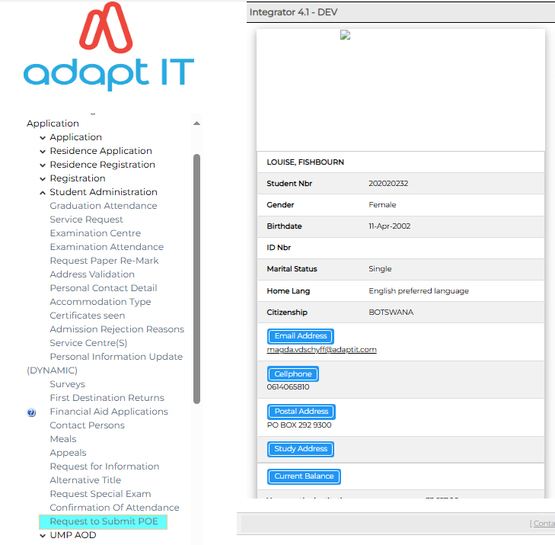
Request Submission
  After a student has completed N6: They can send a request for in service training via iEnabler.
  This is controlled by cycle PR
  It is an extension of the COOP system but focusing on graduations
16

Slide 17
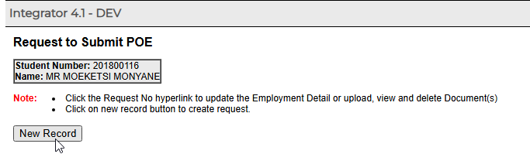
Request Submission
  Student creates a new record: They can send a request for in service training via iEnabler.
17

Slide 18
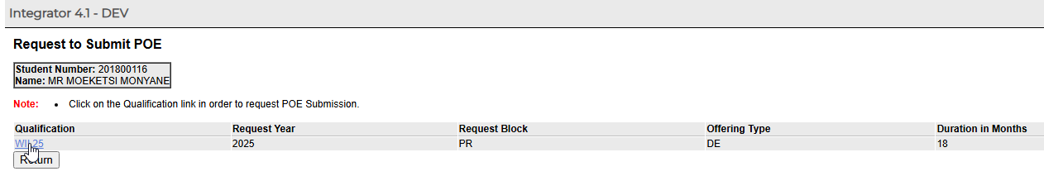
Request Submission
  Qualification selection: The qualification is preselected for the student.
  The system checks if the pre-requisite qualification is passed
  It ensures that the student applies for WIL/request to submit POE on the correct qualification
18

Slide 19
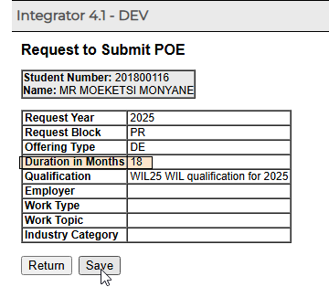
Request Submission
  POE Details:
  The qualification details will be pre-selected and displayed to the student
19

Slide 20
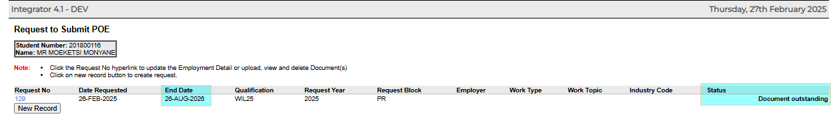
Request Submission
  POE Submission Confirmation:
  The student will be able to use this option to track their POE submission status
  The blank details are updated by the approver of the request upon approval
20

Slide 21
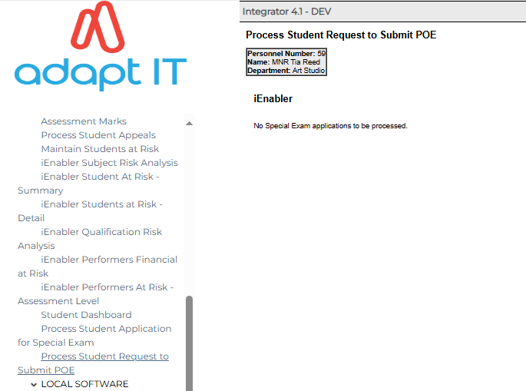
Approval Process
  POE Approval L1: There are 2 levels of approval in this process
  The level 1 approver will see the request and process submitted POEs
21

Slide 22
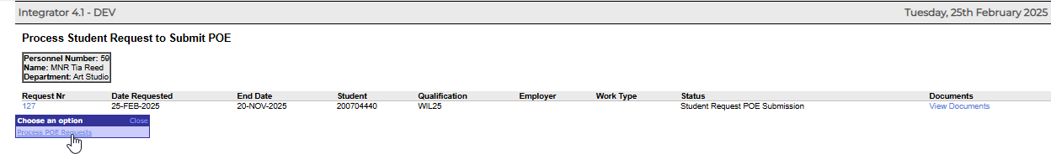
Approval Process
  POE Approval L1: This screen will display all submitted requests as well as the current status
  The approver will be able to view documents from here prior to approval
22

Slide 23
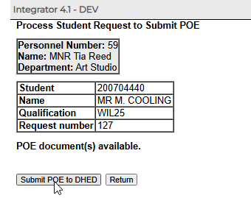
Approval Process
  POE Approval L1: Confirmation
  Route Number
23

Slide 24
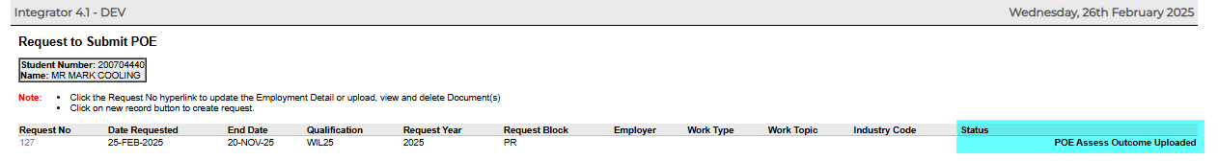
Approval Process
  POE Student iEnabler status:
  Students can view their statuses on iEnabler
  An email is also sent to the student whenever the status of their request changes
24

Slide 25
Ad Hoc Groups

Slide 26
New Group Types
Base Group Types
C – Class Group - Mandatory
P – Practical Group
T – Tutorial Group
Assigned during Registration.
Quota/Min and Max level to consider.
Extended Group Types
V – Virtual Group
L – Lab Group
A - Ad hoc Group
Not directly linked to a student.
No quota/Min and Max level.

Slide 27
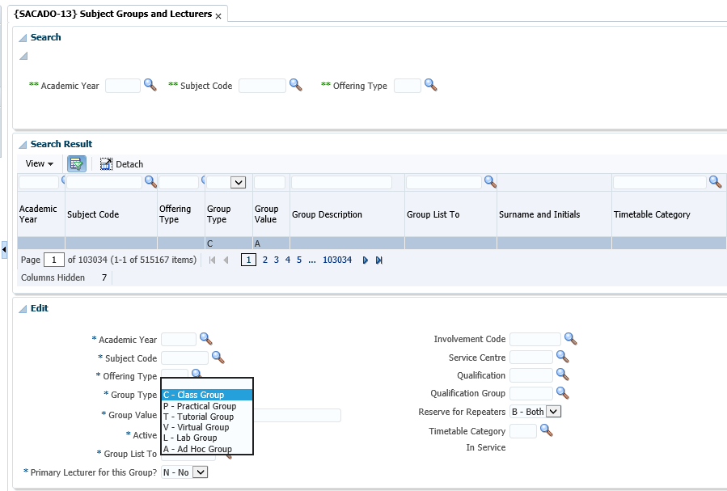
{SACADO-13} Subject Groups and Lecturers

Slide 28
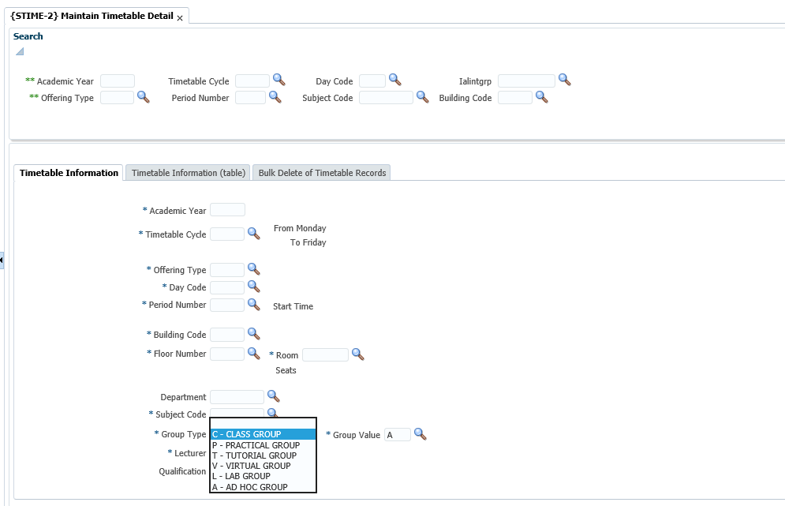
{STIME-2} Maintain Timetable Detail

Slide 29
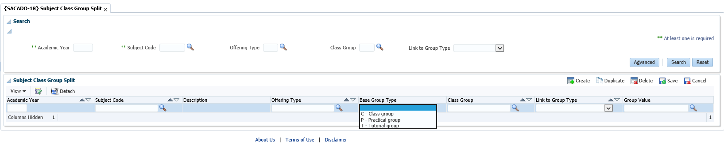
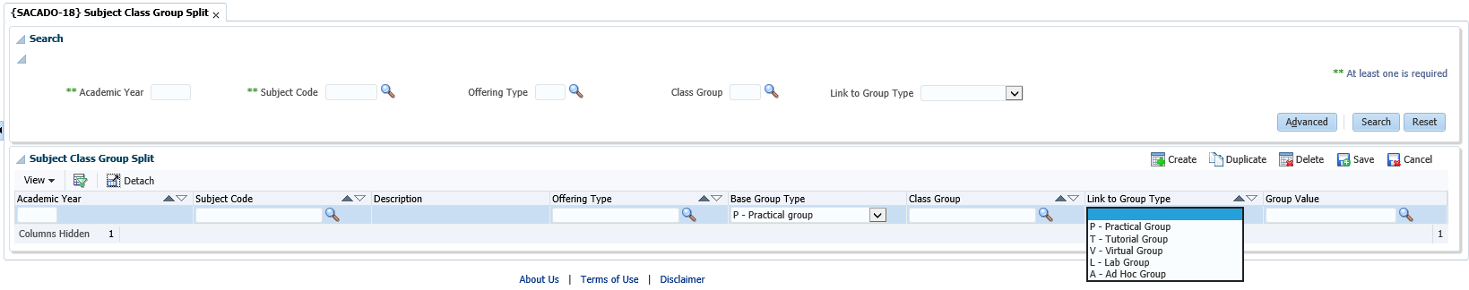
{SACADO-18} Subject Class Group Split

Slide 30
LMS API

Slide 31
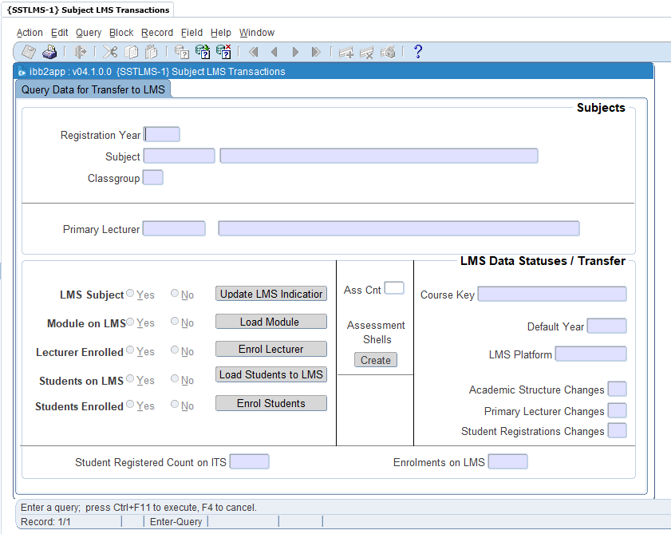
{SSTLMS-1} Subject LMS Transactions

Slide 32
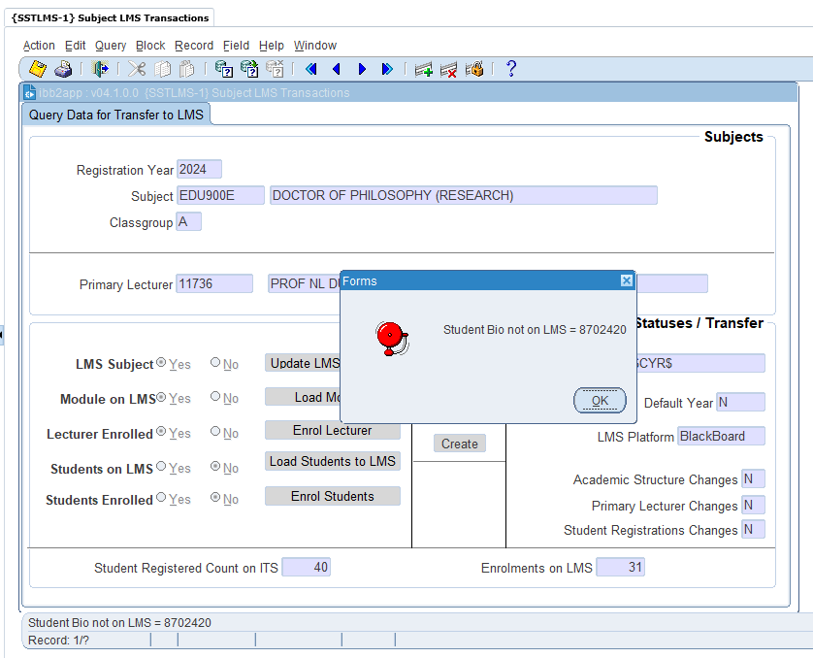
{SSTLMS-1} Subject LMS Transactions

Slide 33
Residence

Slide 34
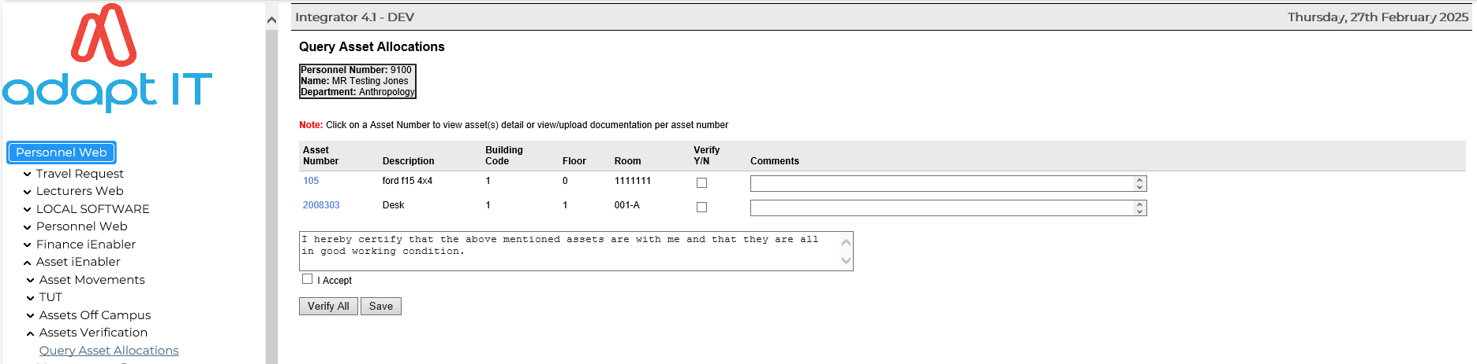
Query Asset Allocation

Slide 35
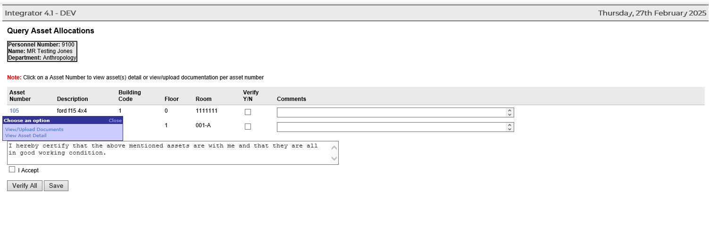
Query Asset Allocation

Slide 36
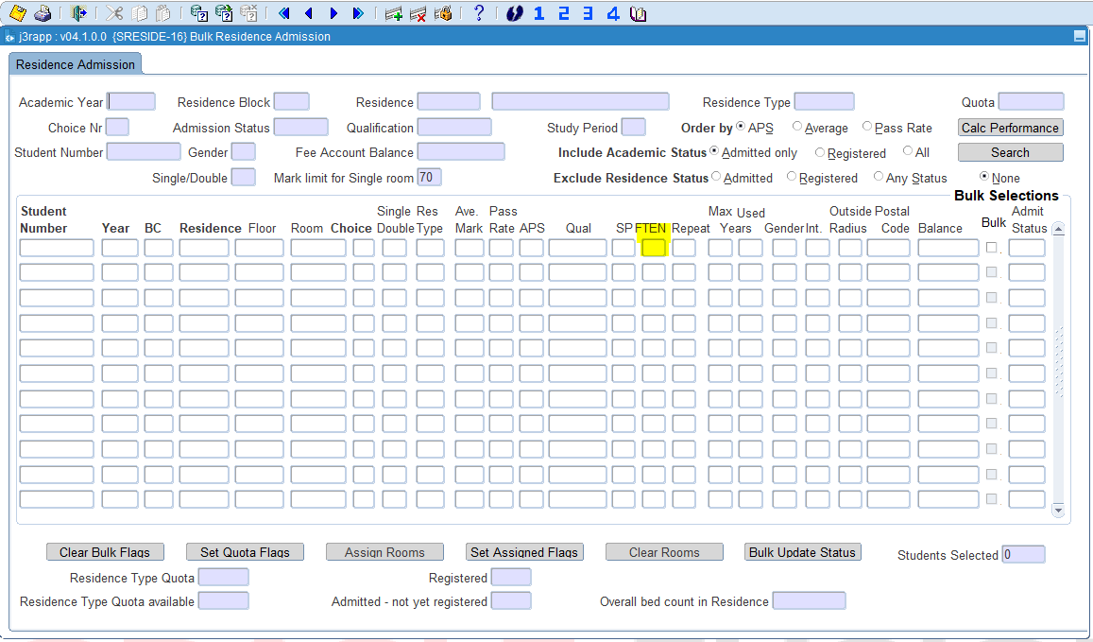
{SRESIDE-16} Bulk Residence Admission

Slide 37
Security on iEnabler

Slide 38

iEnabler Enhancement
Enhanced functioning of Forgot, Change and Request Pin buttons on Login screen
- New, temporary pin is now generated when either of the buttons : Forgot Pin or Request Pin is executed and sent to Web User. User will always be forced to change this system generated Pin on next Login attempt.
- Removed User Number from emails sent following execution of Forgot Pin or Request Pin buttons to enhance security. As a replacement, Email Routing Reference is added to body of the mails to enable backtracking of mails to user numbers.
- For Change Pin button new mail is introduced via new routing type : PWCH to only announce that Pin has been changed without sending actual pin.

Slide 39

Important Advice
Please use password on iEnabler
01
Ensure that your email does not contain both the PIN and username in the same message.
02
Use Single Sign On for iEnabler
03

Slide 40

Future Development: Creating a new routing type
Forgot pin
Request pin
Forgot Student Number

Slide 41
Roadmap

Slide 42
Factors Considered
WSP
Blackboard API
TVET
Alumni TVET Extract
Graduation Refactor
Enhancement
School Leaving Results Botswana
iEnabler (Mark Calculation)
CAS - API
Communication Engine Refactor
New Modules
COOP Refactor
Learner Profile API
Digital signatures
Enrolment & Monitoring - Academic Structure
Blackboard API
Records Management API
HDMS Standardization
DHET Reporting
Library API
Next WIL API
Statutory Reporting Botswana

Slide 43
2025 Student Team Roadmap
Build 100
iEnabler Hardening
Build 104
Exam Cycle Split
Build 108
Central Application Office - API
Blackboard API
CELCAT Automation
ADF Conversion
Registration Quotas
Library API
HDMS Standardization
Graduation Refactor TVET
Alumni TVET Extract
Records Management API
COOP - WIL NxtGen API
Learner Profile
Celcat Automation
Matric Results International Clients
ADF Conversion
Digital Signature
iEnabler Hardening
Mobile Elections Research - API
Automated selection based on pre-set criteria which can be amended
Enrolment & Monitoring - Academic Structure - SAQA notification stop new qualification
Statutory Reporting Botswana
ADF Conversion
iEnabler Hardening

Slide 44

2025 Student Team Roadmap
Build 100
iEnabler Hardening
Build 104
Exam Cycle Split
Build 108
Central Application Office - API
Blackboard API
CELCAT Automation
ADF Conversion
Registration Quotas
Library API
HDMS Standardization
Graduation Refactor TVET
Alumni TVET Extract
Records Management API
COOP - WIL NxtGen API
Learner Profile
Celcat Automation
Matric Results International Clients
ADF Conversion
Digital Signature
iEnabler Hardening
Mobile Elections Research - API
Automated selection based on pre-set criteria which can be amended
Enrolment & Monitoring - Academic Structure - SAQA notification stop new qualification
Statutory Reporting Botswana
ADF Conversion
iEnabler Hardening

